Slide 1
Three Days Workshop On Machine Learning [Day 1]
Organized By:
Association of Computer Engineering Students (ACES)
Eastern Region Campus (ERC), Dharan, Nepal
Instructor:
Manish Bhurtel
AI Engineer at ASMI Corp

Slide 2
MACHINE LEARNING
Machine Learning is the technique of using different algorithm and computations which makes the machine able to recognize and predict the possible outputs.
ML algorithm takes a dataset as an input, learns the patterns/features in it and creates a model. That model will be able to predict the values or categories of the data which it has not seen before.

Slide 3
MACHINE LEARNING
We will be using:
Python Programming Language
Libraries:
Scikit-Learn (For classical ML algorithms like Linear Regression, Decision Tree, Support Vector Machines, etc.)
Keras (For Neural Networks)
Matplotlib (For Visualization)
Numpy (For mathematical computations)
Pandas (For working with tabular data – excel, csv)
Google Colab to implement our code

Slide 4
PYTHON DATA STRUCTURES
LIST | DICTIONARY | TUPLE
Enclosed by Square Brackets [] | Enclosed by Curly Brackets {} | Enclosed by Parentheses ()
Items are indexed from 0 | It contains Key-Value Pair with Key working as indices of the values | Items are indexed from 0
Can contain heterogeneous objects like numbers and strings | Keys can be anything, strings or numbers. | It is immutable. Once a tuple is created, it cannot be altered.
Accessing an item is done by listA[2] | Accessing an item is done by dictA[key_name] | Accessing an Item is done by tupleA[0]
Eg: listA = [‘a’, ‘b’, ‘34’, ‘23’] >>> listA[2] = 34 | Eg: dictA = {‘name’: “Harry”, ‘age’: 24} >>> dictA[age] = 24 | Eg: tupleA = (12, 24, ‘one’) >>> tupleA[1] = 24

Slide 5
SUPERVISED LEARNING
MACHINE LEARNING
A machine learning mechanism in which the machine learns with a “labelled” dataset.
It is called supervised, as it learns with guidance.
The label for a data is predicted and compared with the actual label for that data.
An error is calculated which is used to adjust the parameters so that the model predicts more accurately.
Example: Linear Regression, Neural Networks, etc.

Slide 6
UNSUPERVISED LEARNING
MACHINE LEARNING
A machine learning mechanism in which the machine learns with an “unlabeled” dataset.
It is called unsupervised, as it learns from the data without any guidance.
In this mechanism, machine learns the patterns, similarities and differences between the data.
It then predicts the category for a new data by comparing its pattern with the learned patterns.
Example: K-Means Clustering, etc.

Slide 7
MACHINE LEARNING
REGRESSION:
It is a technique of predicting values of continuous variables.
Ex: Predicting the weight of a person based on age, height, etc.
CLASSIFICATION:
It is a technique of predicting values of discrete or categorical variables.
Ex: Ex: Predicting whether a person has appropriate weight as per his/her age and height, etc.

Slide 8
MACHINE LEARNING
LINEAR REGRESSION
Linear Regression is the technique of predicting the value of a dependent variable using the values of one or more independent variables with a straight line which best fits the data.
Get a sample data
Design a Linear Regression Model to best fit the sample data
Test it for the whole population data

Slide 9
LINEAR REGRESSION
y = ax + b
VARIABLES | EXAMPLE
x: independent variable | Extra working hours by an employee
y: dependent variable whose value is to be predicted | Amount of bonus that an employee may get
b: constant term / intercept | Basic Salary of an Employee
a: coefficient / slope | How much your salary increase with the extra working hours!
Parameters to be adjusted: a and b
i.e. we change the value of a and b such that there is minimum error with respect to all the input values(x)

Slide 10
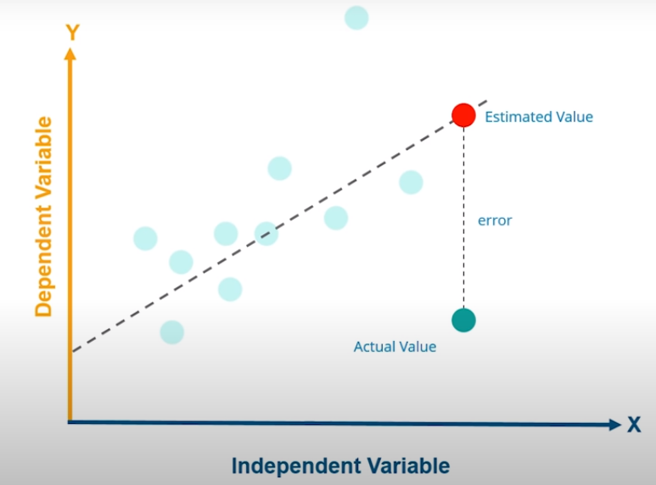
LINEAR REGRESSION

Slide 11
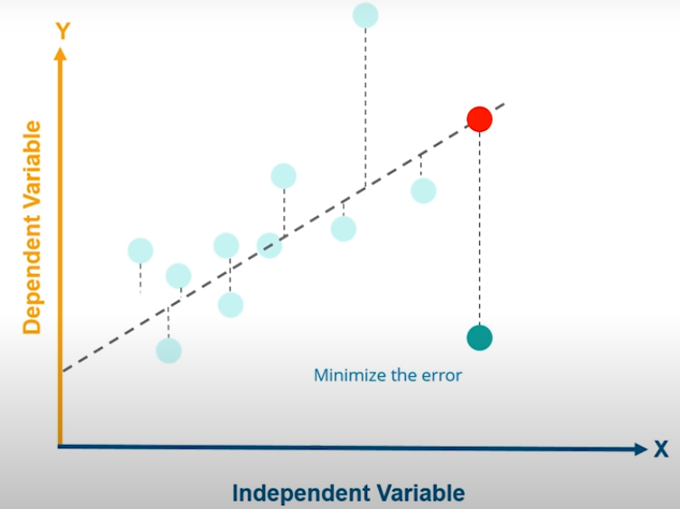
LINEAR REGRESSION

Slide 12
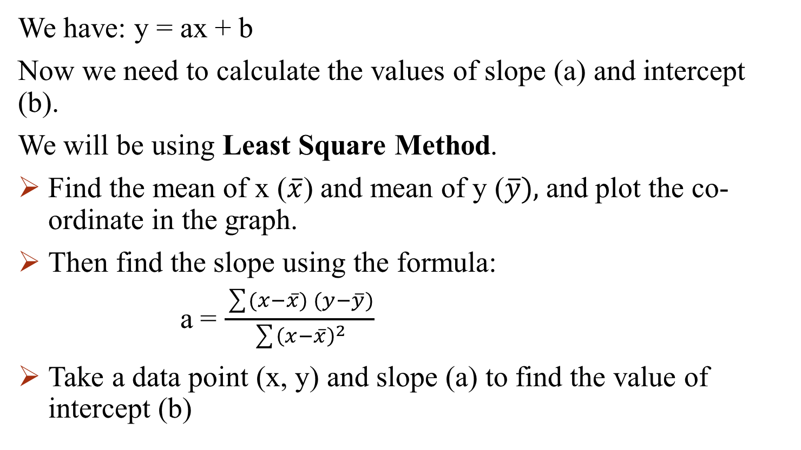
LINEAR REGRESSION
We have: y = ax + b
Now we need to calculate the values of slope (a) and intercept (b).
We will be using Least Square Method.
Find the mean of x ($\overline{x}$) and mean of y ($\overline{y}),$and plot the co-ordinate in the graph.
Then find the slope using the formula:
a = $\frac{\sum{(x}−\overline{x}) (y−\overline{y})}{\sum{{\left(x−\overline{x}\right)}^{2}}}$
Take a data point (x, y) and slope (a) to find the value of intercept (b)

Slide 13
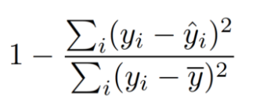
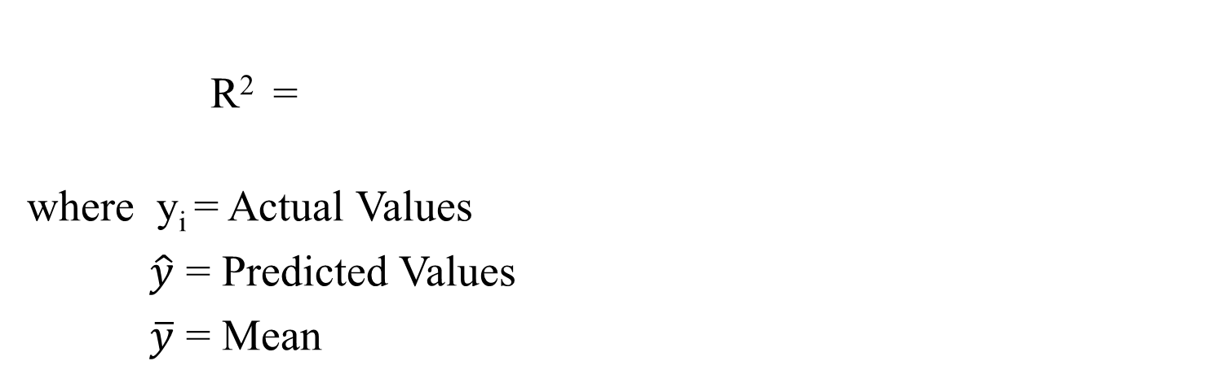
LINEAR REGRESSION
Evaluation will be made using R² score is calculated as:
R-squared score represents how much the data is converged around the mean.
A low R² score means that the data is too far from the mean or there are lots of outliers in the data.
A high R² score means that the data is converged and the line more accurately fits the data.
R² =
where y_{i} = Actual Values
$\hat{y}$ = Predicted Values
$\overline{y}$ = Mean

Slide 14
PANDAS
Pandas DataFrame: It is like the hybrid of Python lists and dictionaries as it has the keys as well as indices.
DataFrames are the 2D data structures with columns and rows.
Here, we can assign anything as indices to rows and columns.
 | emdId | Name | Age | Salary
0 | 101 | John | 25 | 45000
1 | 102 | Harry | 27 | 60000
2 | 103 | Peter | 28 | 65000
3 | 104 | Julie | 23 | 35000
Label based indexing: Any labels can be kept as indices. We can access the data items based on labels
Position based indexing: Indices based on position (starting from 0)

Slide 15
Head Brain Dataset

Slide 16
IMPLEMENTATION OF LINEAR REGRESSION USING SCIKIT LEARN
LINEAR REGRESSION

Slide 17
ARTIFICIAL NEURAL NETWORKS (ANN)
ANN is the analogy of the biological neural connections and flow of information which takes an input (senses), processes it and makes some predictions (output).
Lots and lots of neurons in our body process together to take an action. Similarly, lots and lots of artificial neurons act together to categorize a data.

Slide 18
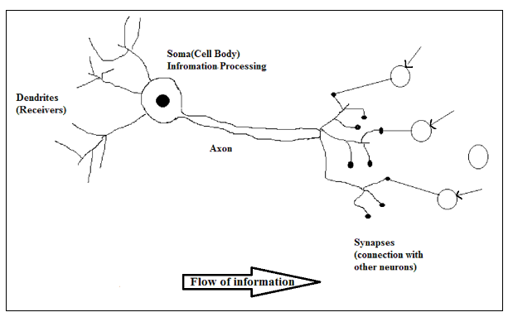
ARTIFICIAL NEURAL NETWORKS (ANN)
Biological NN | Artificial NN
Soma | Node (neuron)
Dendrite | Input
Synapse | Weights
Axon | Output

Slide 19

Structure of ANN
ARTIFICIAL NEURAL NETWORKS (ANN)
INPUTS
X₁
WEIGHTS
NODE/ NEURON
w₁
X₂
w₂
OUTPUT
w₃
$$Σ$$
f
Y
X₃
w_{n}
X_{n}

Slide 20




ARTIFICIAL NEURAL NETWORKS (ANN)
NEURAL NETWORK WITH SINGLE HIDDEN LAYER
INPUT LAYER
HIDDEN LAYER
OUTPUT LAYER
$$Σ$$
f
X₁
X₂
Probability
0.9
$$Σ$$
f
$$Σ$$
f
X₃
X_{n}
$$Σ$$
f

Slide 21







ARTIFICIAL NEURAL NETWORKS (ANN)
Note: In every hidden layer, the data is broken down into pieces to extract more subtle information
INPUT LAYER
HIDDEN LAYER 1
HIDDEN LAYER 2
OUTPUT LAYER
$$Σ$$
f
$$Σ$$
f
X₁
Probability
X₂
$$Σ$$
f
0.9
X₃
$$Σ$$
f
$$Σ$$
f
$$Σ$$
f
0.1
X_{n}
$$Σ$$
f
$$Σ$$
f

Slide 22
ARTIFICIAL NEURAL NETWORKS (ANN)
In the previous slide, what we learned was “Forward Propagation”.
Steps in forward propagation:
Feed the input into the first layer of NN.
Assign the random weights connecting the input data to the nodes in hidden layer.
Calculate the weighted sum of all those values and the pass into the activation function.
The activation function calculates the probability.
The output node with the maximum probability is activated as the final output label.
In binary classification, generally we use sigmoid functions.
In multiclass classification, generally we use softmax function

Slide 23
ARTIFICIAL NEURAL NETWORKS (ANN)
Now since we have obtained the final output probability, we calculate the loss by comparing the output with the actual output
To estimate the loss we use a “Loss Function”. Generally, we use:
Binary Cross Entropy Loss: For binary classification
Categorical Cross Entropy Loss: For multiclass classification
Now our target is to minimize the loss by adjusting the trainable parameters w₁, w₂, … , w_{n}.
To adjust the parameter, we do back propagation, adjusting each weights associated to a neuron from backward. This process is called “Optimization”.
Then again forward propagation is repeated with the new weights to obtain more accurate results.
Generally, we use “Accuracy” metric for evaluation.

Slide 24
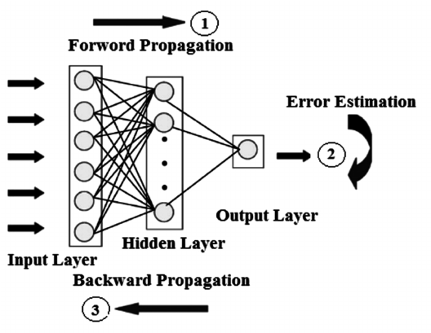
ARTIFICIAL NEURAL NETWORKS (ANN)
So basically we have four steps in Training of a Neural Network:
Forward Pass
Error Estimation
Backward Pass
Weight Update

Slide 25
ARTIFICIAL NEURAL NETWORKS (ANN)
Terminologies (we will use in implementation):
Optimizer: Adam
Loss Function: Categorical Cross Entropy
Evaluation Metric : Accuracy
Epochs (Iterations): 100
Batch Size (Data batches): 5
Activation Function: Sigmoid, SoftMax

Slide 26
ARTIFICIAL NEURAL NETWORKS (ANN)
IRIS DATASET

Slide 27
ARTIFICIAL NEURAL NETWORKS (ANN)
IMPLEMENTATION OF
ANN
USING KERAS

